Slide 1


Slide 2
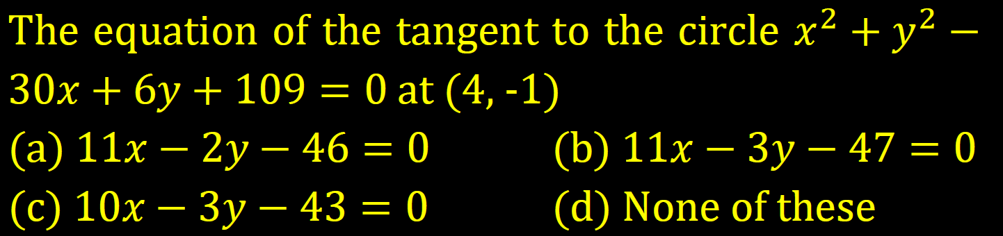

Slide 3
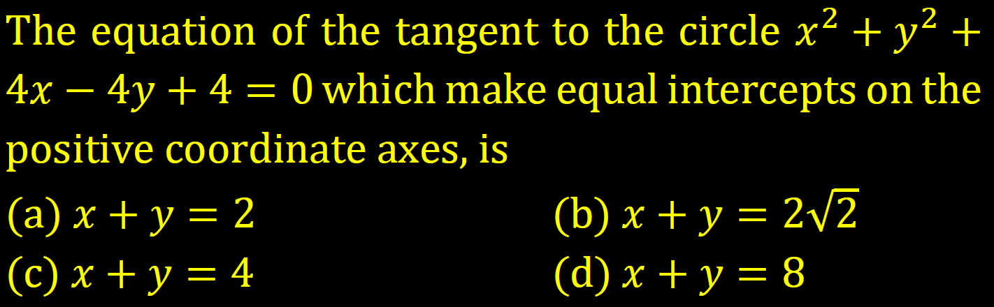

Slide 4
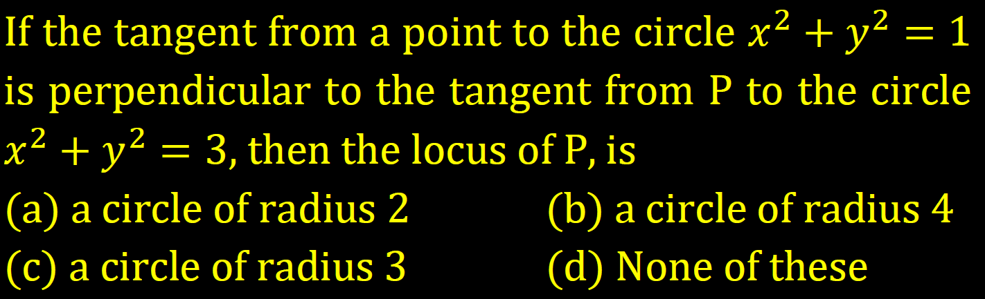

Slide 5
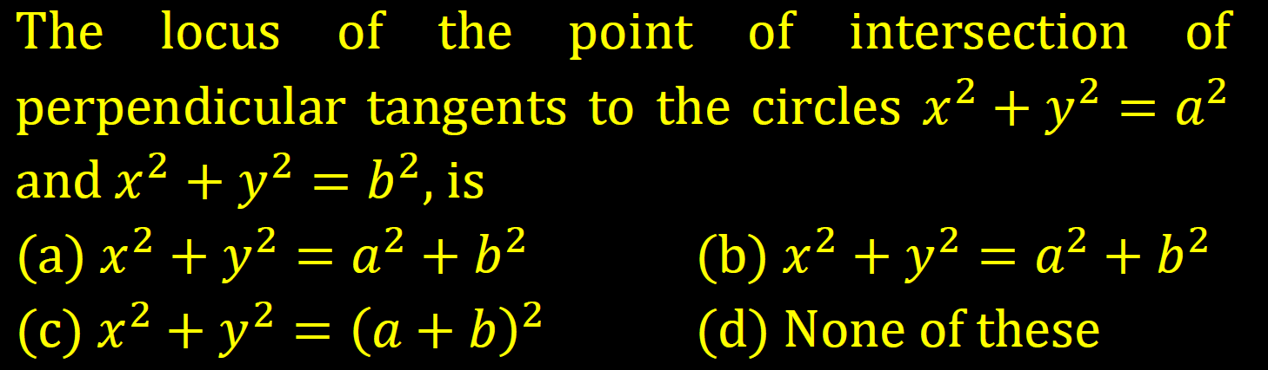

Slide 6
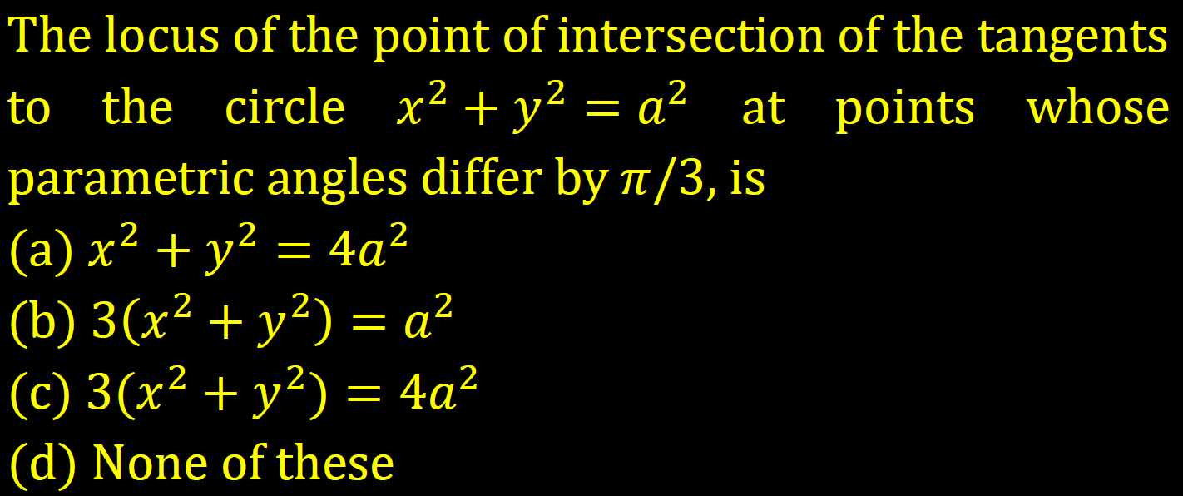

Slide 7
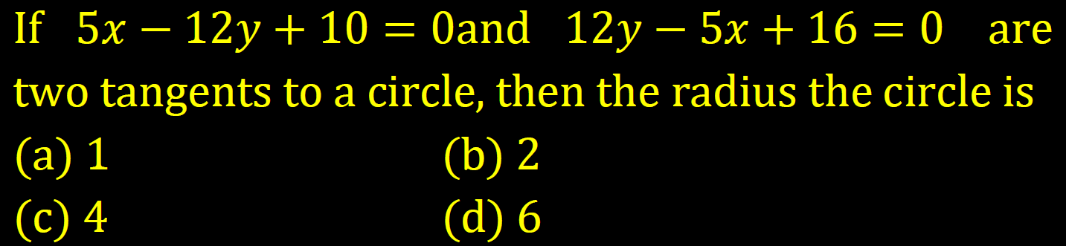

Slide 8
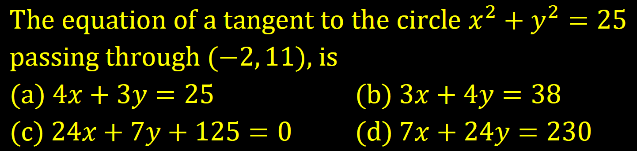

Slide 9
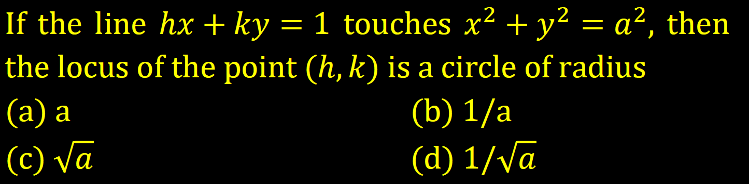

Slide 10
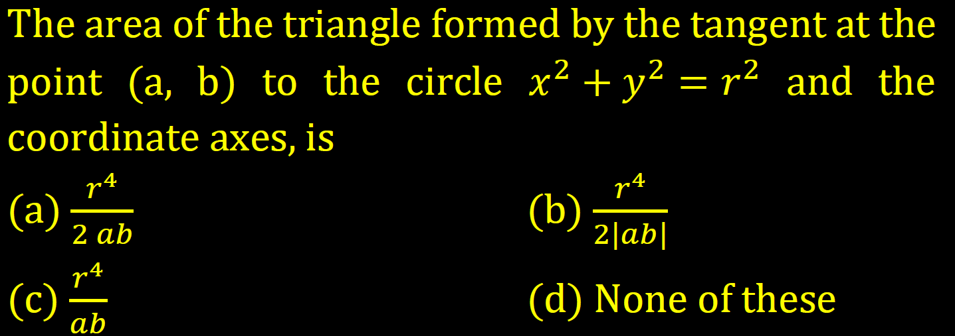

Slide 11
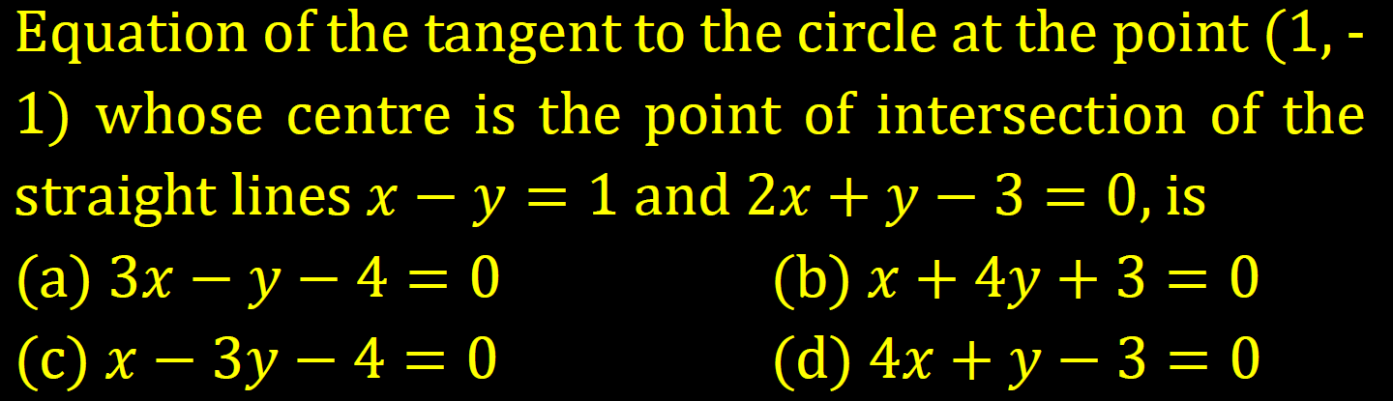

Slide 12
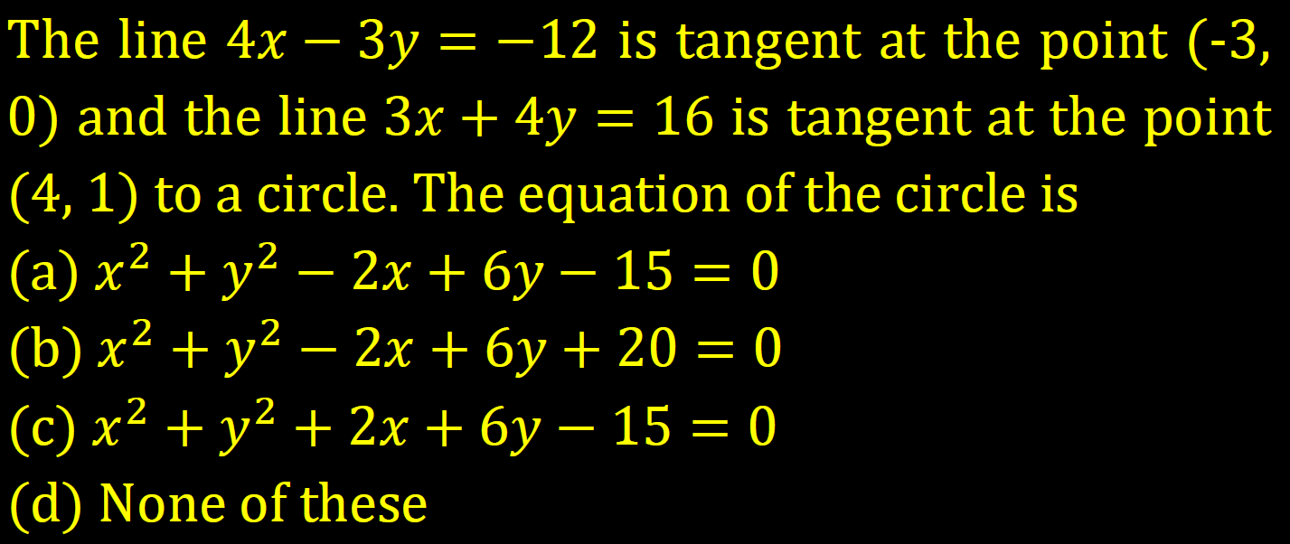

Slide 13
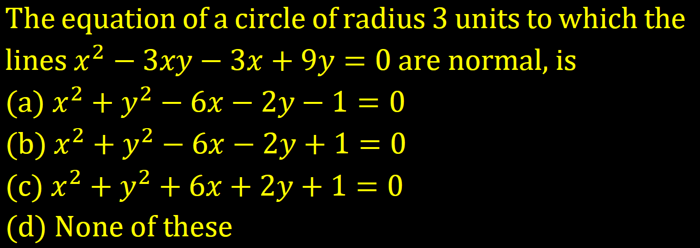

Slide 14
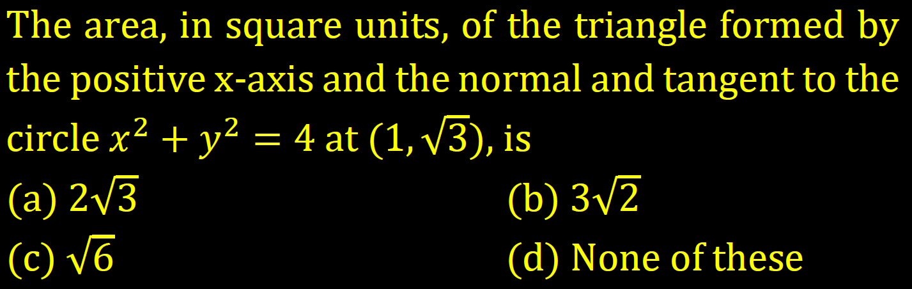

Slide 15
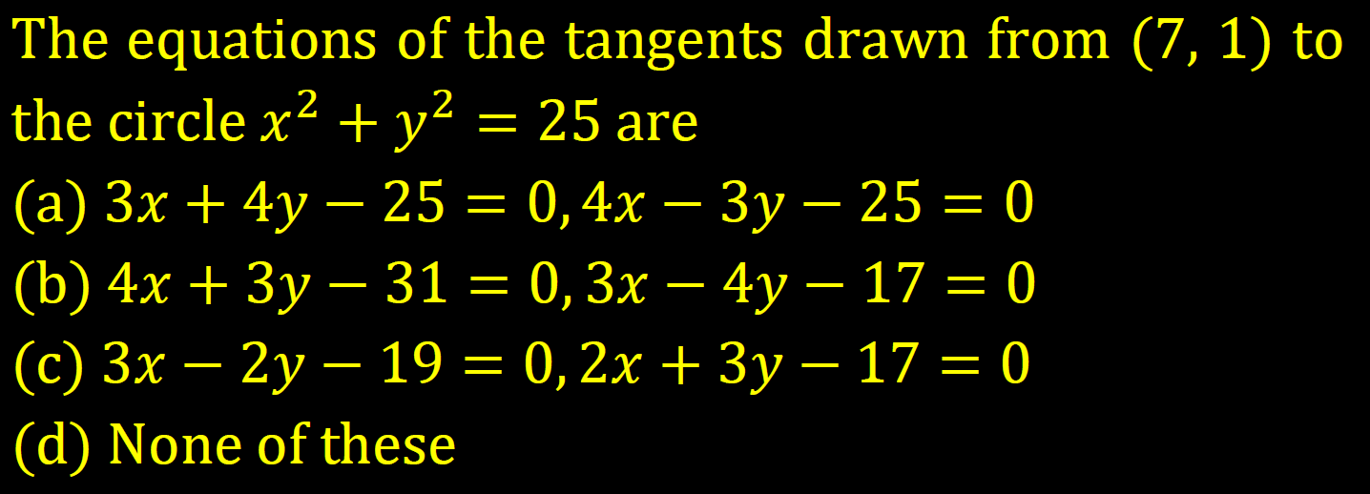

Slide 16
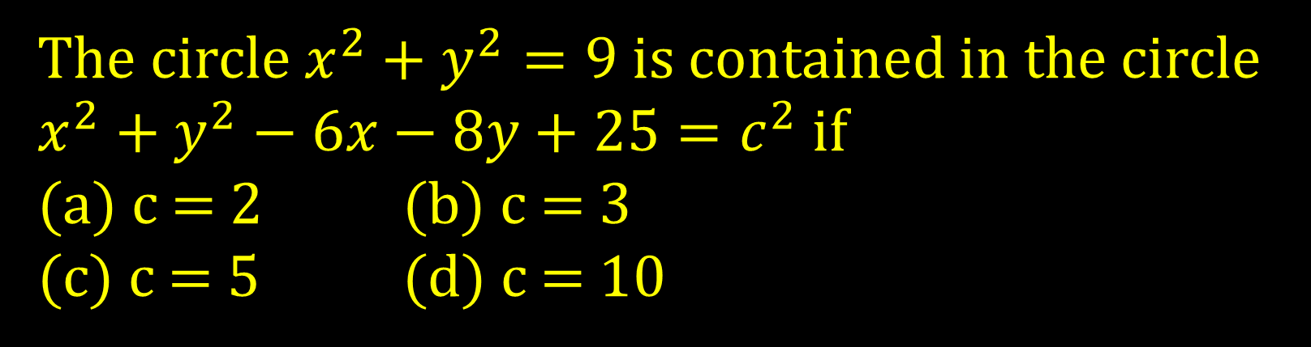
The circle $x^{2}+y^{2}=9$is contained in the circle $x^{2}+y^{2}−6x−8y+25=c^{2}$if
(a) c = 2 (b) c = 3
(c) c = 5 (d) c = 10

Slide 17
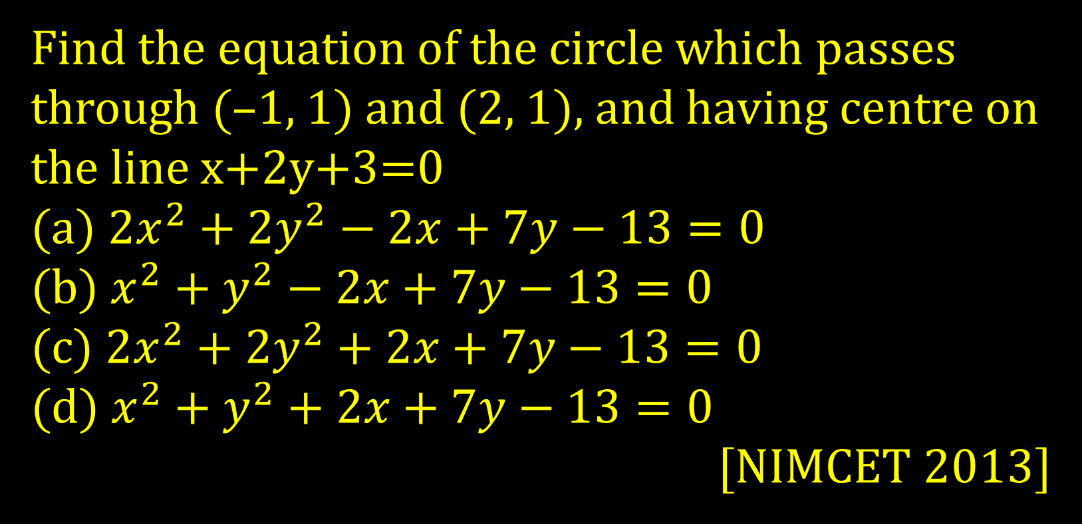
Find the equation of the circle which passes through (–1, 1) and (2, 1), and having centre on the line x+2y+3=0
(a) $2x^{2}+2y^{2}−2x+7y−13=0$
(b) $x^{2}+y^{2}−2x+7y−13=0$
(c) $2x^{2}+2y^{2}+2x+7y−13=0$
(d) $x^{2}+y^{2}+2x+7y−13=0$
[NIMCET 2013]

Slide 18
The lines 3x – 4y + 4 = 0 and 6x – 8y – 7 = 0 are tangent to the same circle. The radius of the this circle is
(a) 3/2 (b) 3/4
(c) 4/5 (d) 7/10
[NIMCET 2013]

Slide 19
A circle touches the X-axis and also touches another circle with center at (0, 3) and radius 2. Then, the locus of the center of the first circle is
(a) A parabola (b) a hyperbola
(c) A circle (d) an ellipse
[NIMCET 2015]

Slide 20
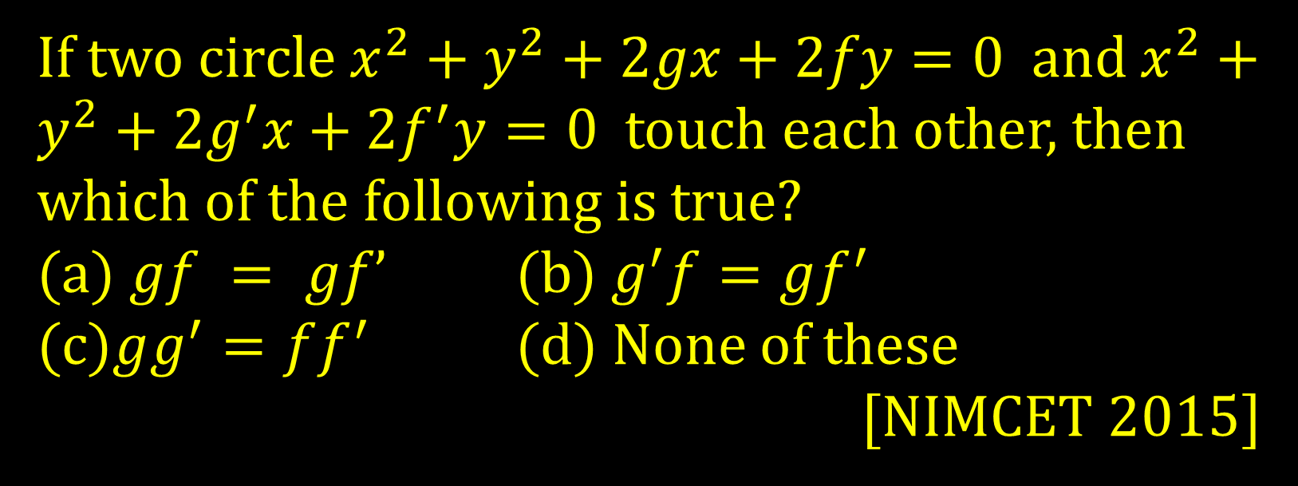
If two circle $x^{2}+y^{2}+2gx+2fy=0$ and $x^{2}+y^{2}+2g^{′}x+2f^{′}y=0$ touch each other, then which of the following is true?
(a) $gf = gf’$ (b) $g^{′}f=gf^{′}$
(c)$gg^{′}=ff^{′}$ (d) None of these
[NIMCET 2015]

Slide 21
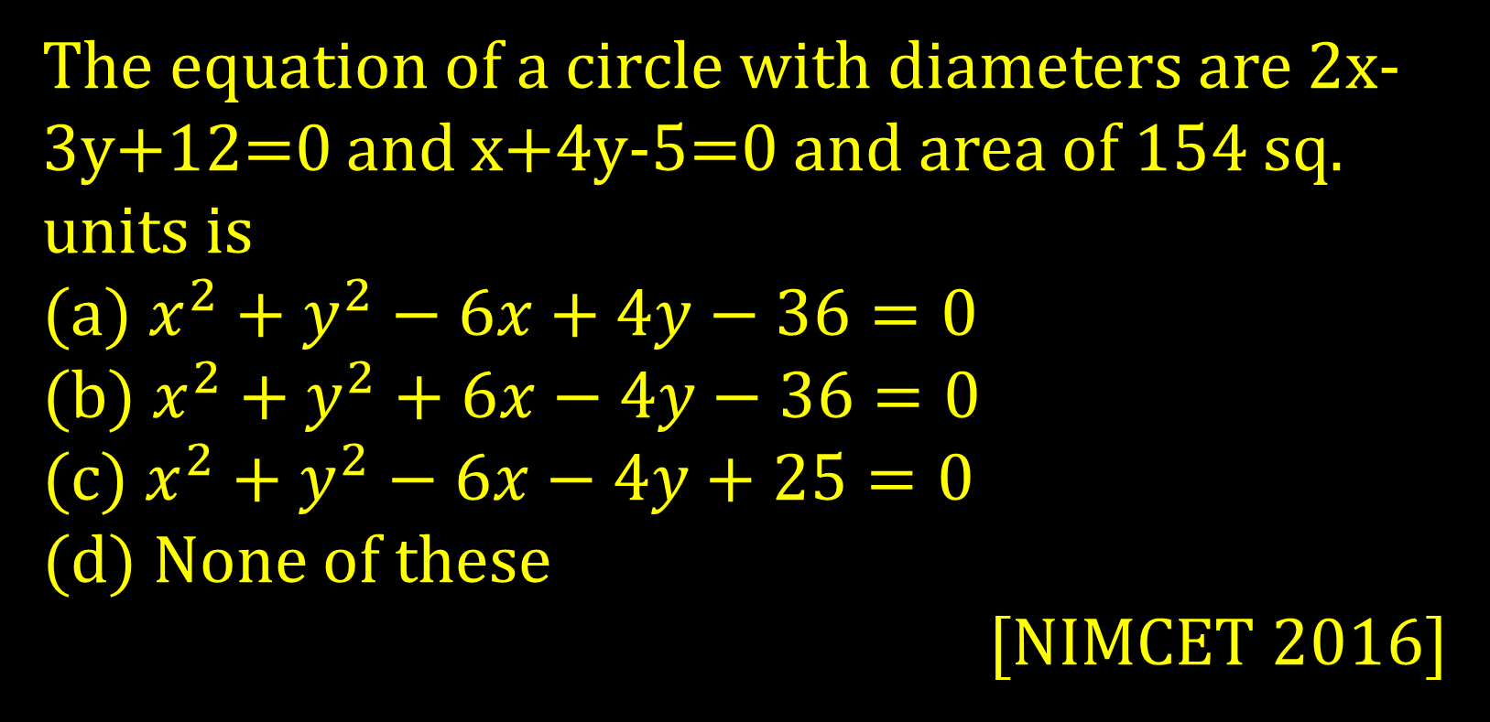
The equation of a circle with diameters are 2x-3y+12=0 and x+4y-5=0 and area of 154 sq. units is
(a) $x^{2}+y^{2}−6x+4y−36=0$
(b)$x^{2}+y^{2}+6x−4y−36=0$
(c) $x^{2}+y^{2}−6x−4y+25=0$
(d) None of these
[NIMCET 2016]

Slide 22
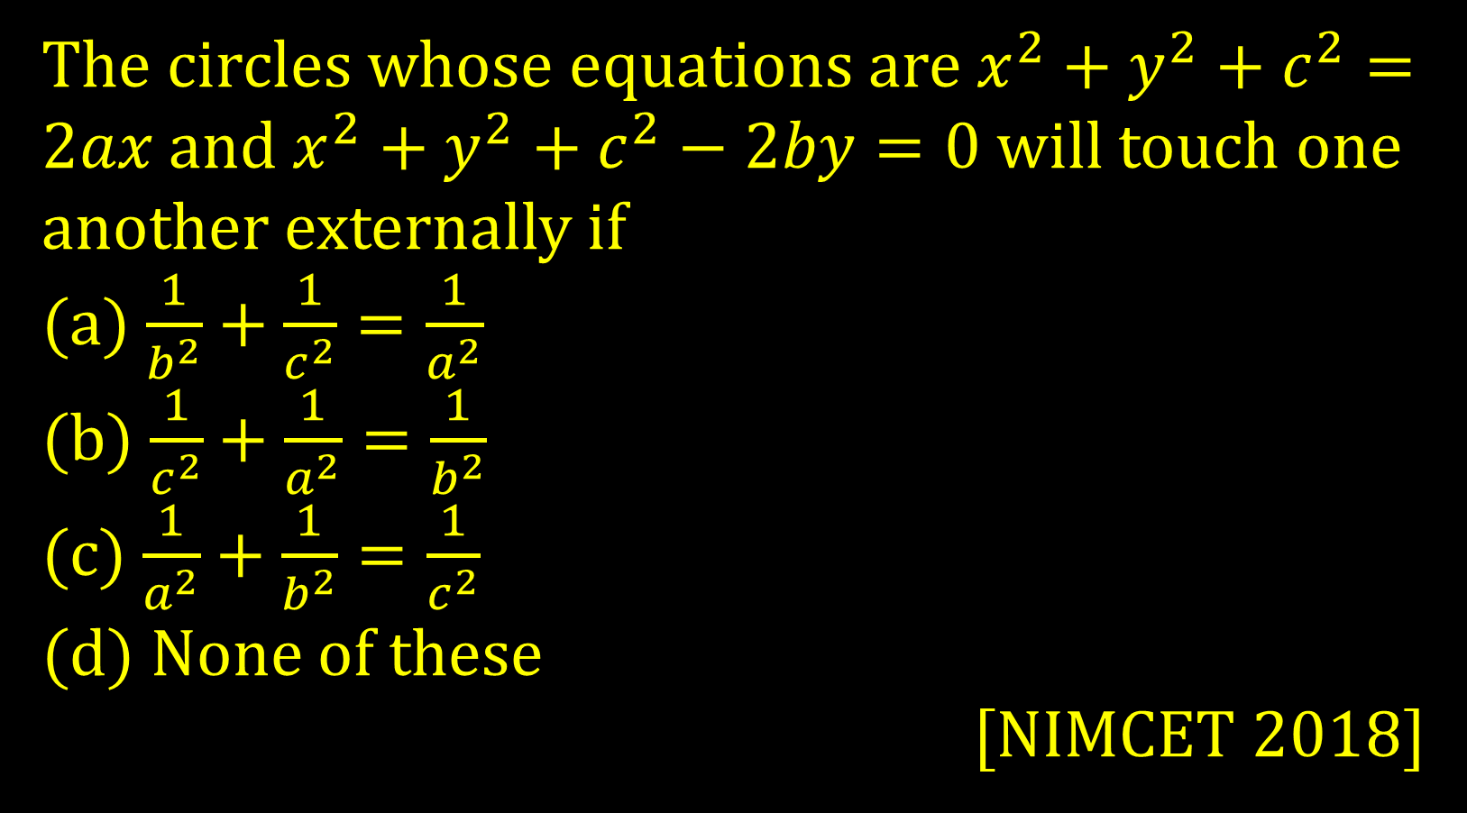
The circles whose equations are $x^{2}+y^{2}+c^{2}=2ax$ and $x^{2}+y^{2}+c^{2}−2by=0$ will touch one another externally if
(a) $\frac{1}{b^{2}}+\frac{1}{c^{2}}=\frac{1}{a^{2}}$
(b) $\frac{1}{c^{2}}+\frac{1}{a^{2}}=\frac{1}{b^{2}}$
(c) $\frac{1}{a^{2}}+\frac{1}{b^{2}}=\frac{1}{c^{2}}$
(d) None of these
[NIMCET 2018]

Slide 23
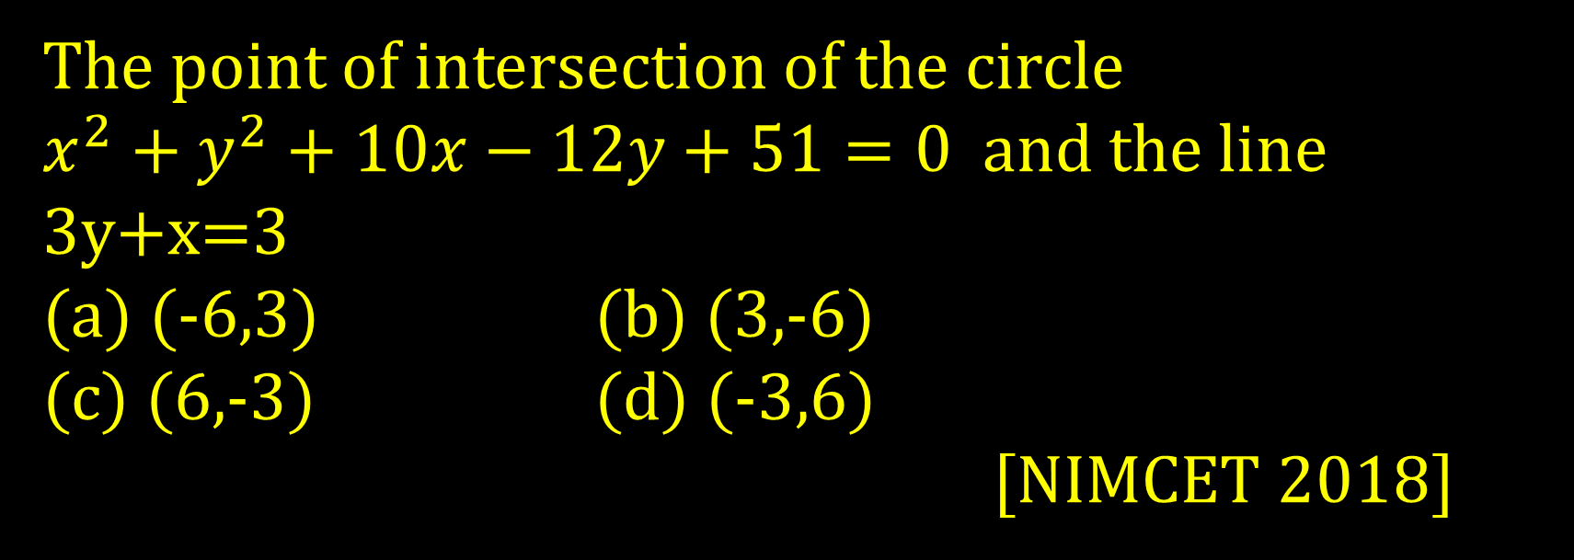
The point of intersection of the circle $x^{2}+y^{2}+10x−12y+51=0$and the line 3y+x=3
(a) (-6,3) (b) (3,-6)
(c) (6,-3) (d) (-3,6)
[NIMCET 2018]

Slide 24
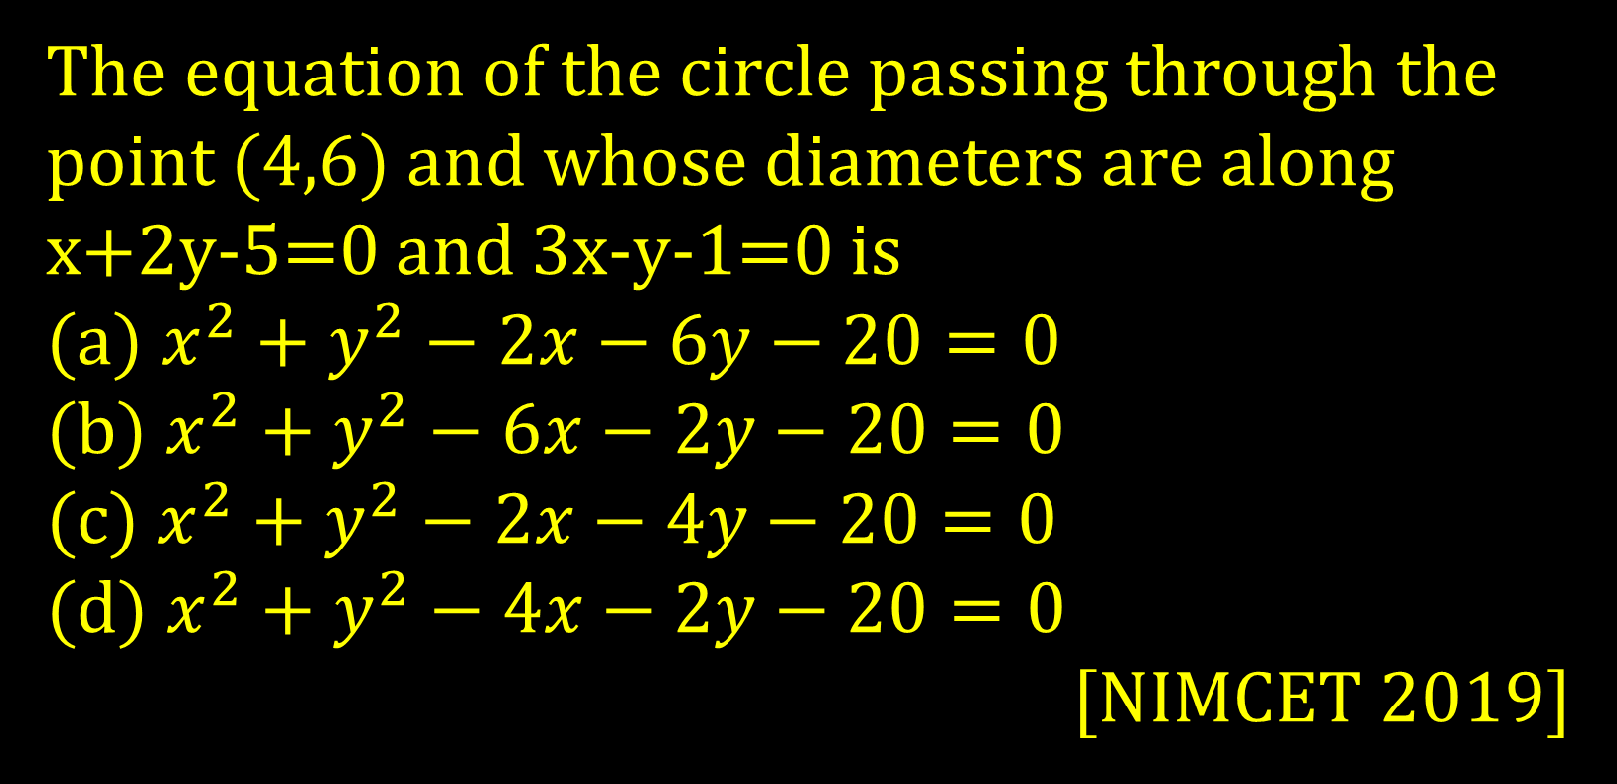
The equation of the circle passing through the point (4,6) and whose diameters are along x+2y-5=0 and 3x-y-1=0 is
(a) $x^{2}+y^{2}−2x−6y−20=0$
(b) $x^{2}+y^{2}−6x−2y−20=0$
(c) $x^{2}+y^{2}−2x−4y−20=0$
(d) $x^{2}+y^{2}−4x−2y−20=0$
[NIMCET 2019]

Slide 25
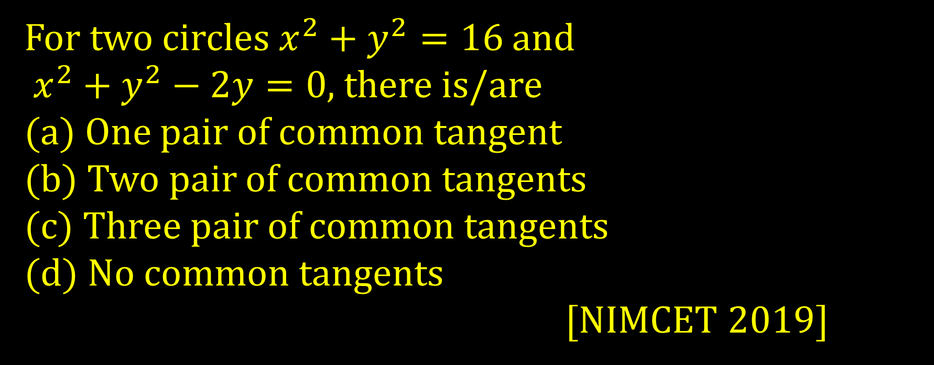
For two circles $x^{2}+y^{2}=16$ and $x^{2}+y^{2}−2y=0$, there is/are
(a) One pair of common tangent
(b) Two pair of common tangents
(c) Three pair of common tangents
(d) No common tangents
[NIMCET 2019]

Slide 26
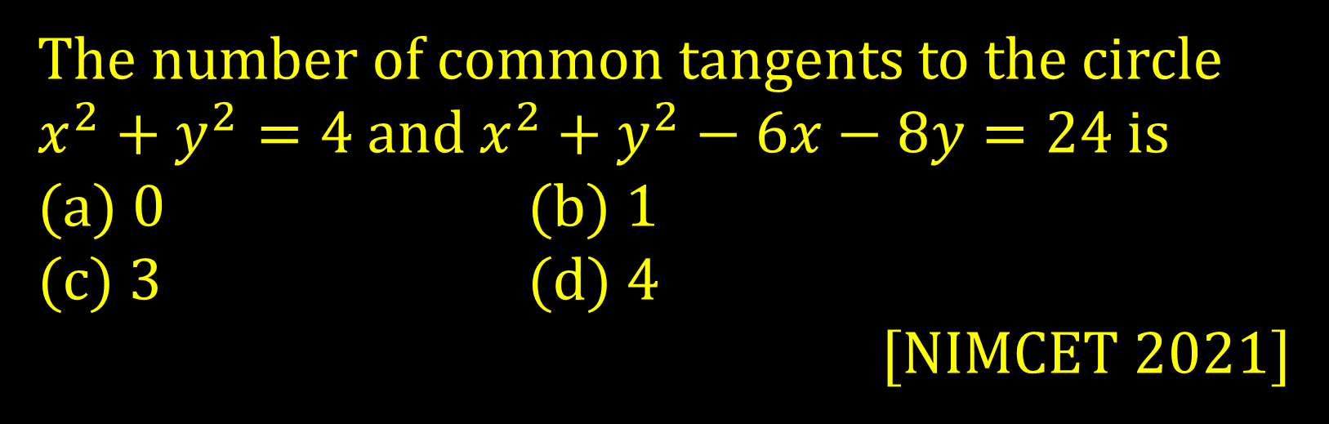
The number of common tangents to the circle
$x^{2}+y^{2}=4$ and $x^{2}+y^{2}−6x−8y=24$ is
(a) 0 (b) 1
(c) 3 (d) 4
[NIMCET 2021]

Slide 27
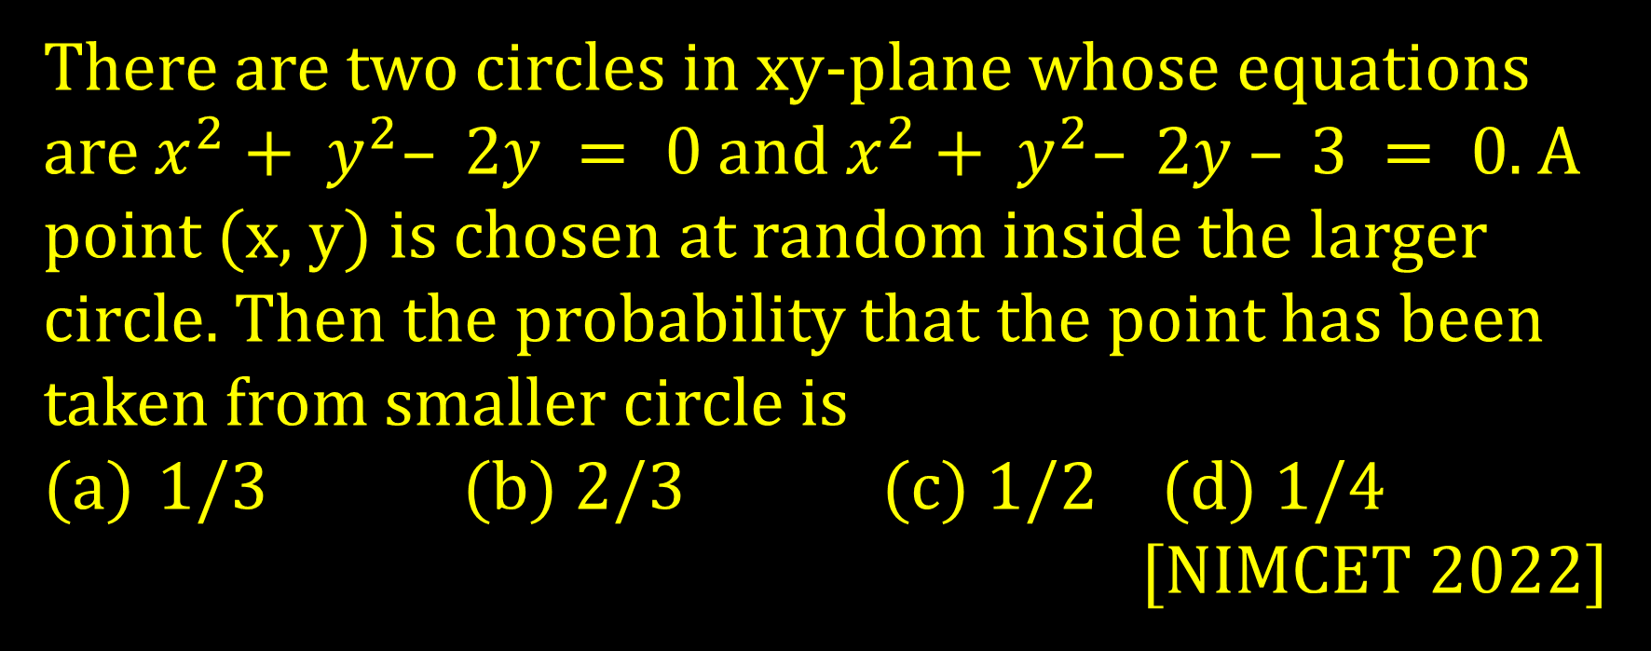
There are two circles in xy-plane whose equations are $x^{2}+ y^{2}– 2y = 0$ and $x^{2}+ y^{2}– 2y – 3 = 0$. A point (x, y) is chosen at random inside the larger circle. Then the probability that the point has been taken from smaller circle is
1/3 (b) 2/3 (c) $1/2$ (d) $1/4$
[NIMCET 2022]

